Slide 1
Currency Converter in Java
Mini Project
Name- Vansh Tomar
University Roll no- 2021517
Sec- E

Slide 2
Understanding the Currency conversion
Currency conversion is the process of transforming one currency into another based on the current exchange rate. This is a crucial functionality for individuals and businesses who need to conduct international transactions or compare prices across different countries.

Slide 3
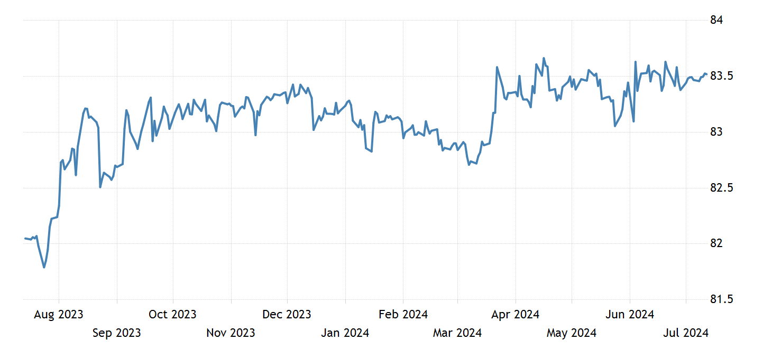
Indian Rupee forecast

Slide 4
We have made a java Swing-based currency converter application:
1. Components we have used in this application are:
GUI design : a graphical user interface for user to convert one currency to another
Event Handling : When the user interacts with the application it performs event.
Logic for currency converter: using the exchange rates of currency we can convert currencies .
2.Event Handling – it performs the conversion by clicking convert button it triggers he currency conversion process.
3. Logic for currency conversion – get the amount from JTextField and select currency from JComboBox and calculate the converted amount .

Slide 5
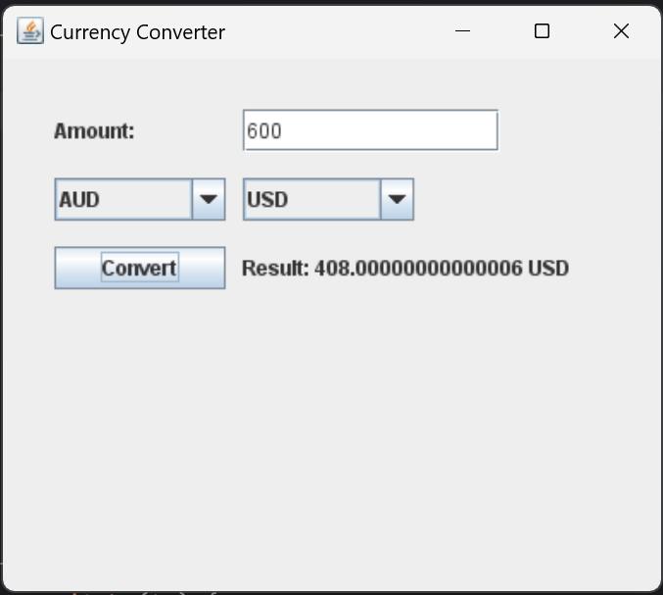
Interface of currency converter

Slide 6
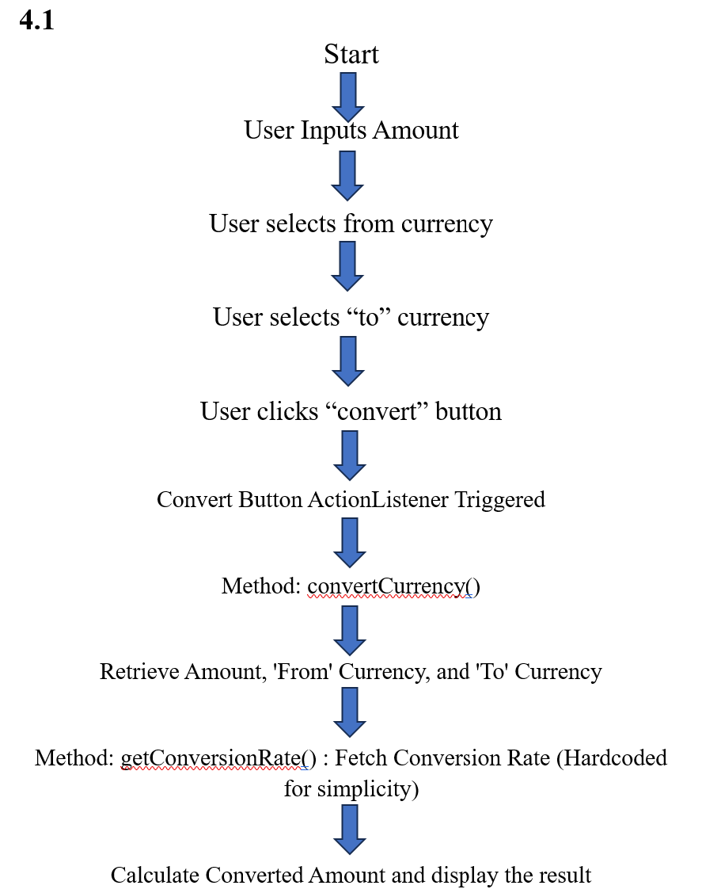

Slide 7
Conclusion and Future Work
This project can be expanded by adding more currencies and providing the exchange rate of the currencies and current market value.
By adding Historic data - User can see the past rates and value of the currency and current status.
Charts can be used to represent the fluctuation in rates of currencies.
By customizing the GUI with animations by using css and js.
Adding themes can make application interactive.
By making it responsive and user friendly.
Creating Multilingual environment to help different regions people to use it.
Different languages can be provided which are widely spoken like English, Spanish, German,Hindi

